Slide 1


M.Tech Program
Advanced Industry Integrated Programs
Jointly offered by University and LTIMindTree
Multi-Agent AI Travel Planner with Real-Time Guidance
Team Member
Kaviya V
M. Tech (Artificial Intelligence and Machine Learning)
VIT Vellore
Knowledge partner | Implementation partner

Slide 2
Multi-Agent AI Travel Planner with Real-Time Guidance
Introduction
Combines LLM intelligence with Google Maps precision.
Generates dynamic itineraries.
Recommends personalized points of interest.
Supports multilingual voice input.
Enables shareable trip links.

Slide 3
Multi-Agent AI Travel Planner with Real-Time Guidance
Objective
Personalizes itineraries using LLMs.
Integrates real-time geographic data.
Recommends diverse POIs.
Enables interactive map visualizations.
Supports shareable links and modular architecture.

Slide 4
Multi-Agent AI Travel Planner with Real-Time Guidance
Scope
Supports trip planning across car, bike, and walking modes.
Dynamically suggests multi-category POIs.
Displays stops with category-specific markers.
Offers real-time route generation and multilingual voice input.
Provides shareable trip links with a modular, scalable architecture.

Slide 5
Multi-Agent AI Travel Planner with Real-Time Guidance
Literature Review
[1] J. Ge, B. Liu, and J. Wang, “A Multi-Agent Solution to Personalized Travel Planning,” arXiv preprint arXiv:2505.10922, May 2025.
[2] Y. Suresh, S. Joshi, S. C, S. Poojary, and S. Reddy, “Smart Travel Assistance using Machine Learning and Generative Artificial Intelligence,” in Proc. Int. Conf. on Intelligent Computing and Control Systems (ICICCS), IEEE, 2025.

Slide 6
Multi-Agent AI Travel Planner with Real-Time Guidance
Literature Review
[3] Z. Shao, J. Wu, W. Chen, and X. Wang, “Personal Travel Solver: A Preference-Driven LLM-Solver System for Travel Planning,” in Proc. 63rd Annual Meeting of the Association for Computational Linguistics (ACL), pp. 27622–27642, 2025.
[4] T. Primya, G. Kanagaraj, K. S, K. VK, and N. S, “GenAI-powered Itinerary Planner,” in Proc. 3rd Int. Conf. on Advancements in Electrical, Electronics, Communication, Computing and Automation (ICAECA), IEEE, 2025.

Slide 7
Multi-Agent AI Travel Planner with Real-Time Guidance
Literature Review
[5] A. Vayal, Y. Mungekar, P. Autade, and I. Bhattacharya, “AI Based Personalized Trip Planner with Multi-Criteria Optimization,” Int. Res. J. Eng. Technol. (IRJET), vol. 12, no. 6, pp. 1208–1211, Jun. 2025.
[6] N. R. G. Merlin, A. D., S. Devilavanya, P. K. S. S. Kumari, and T. Jayakumar, “Cutting-Edge Travel Planner: Intelligent Route Recommendation System using Enhanced Learning Scheme with AI Principles,” in Proc. 9th Int. Conf. on Science Technology Engineering and Mathematics (ICONSTEM), IEEE, 2024.

Slide 8
Multi-Agent AI Travel Planner with Real-Time Guidance
Summary of Literature
CollabRouteNet: Hybrid AI model for smart route recommendations.
Personal Travel Solver: LLM + solver for personalized, constraint-based planning.
Smart Travel Assistance: ML + GenAI for itinerary, crowd, and weather insights.

Slide 9
Multi-Agent AI Travel Planner with Real-Time Guidance
Summary of Literature
GenAI Planner: Claude 3.5 + RAG for dynamic, voice-enabled trip planning.
IRJET Planner: GPT + APIs for multi-criteria, real-time itinerary generation.
VAIAGE: Multi-agent LLM system for adaptive, end-to-end travel planning.

Slide 10
Multi-Agent AI Travel Planner with Real-Time Guidance
Research Gap
Planning vs. Real-Time Execution.
Reliance on Historical Data.
Fragmented Technical Integration.
Lack of Granular, Vehicle-Specific Routing.
Reactive vs. Proactive Guidance.

Slide 11
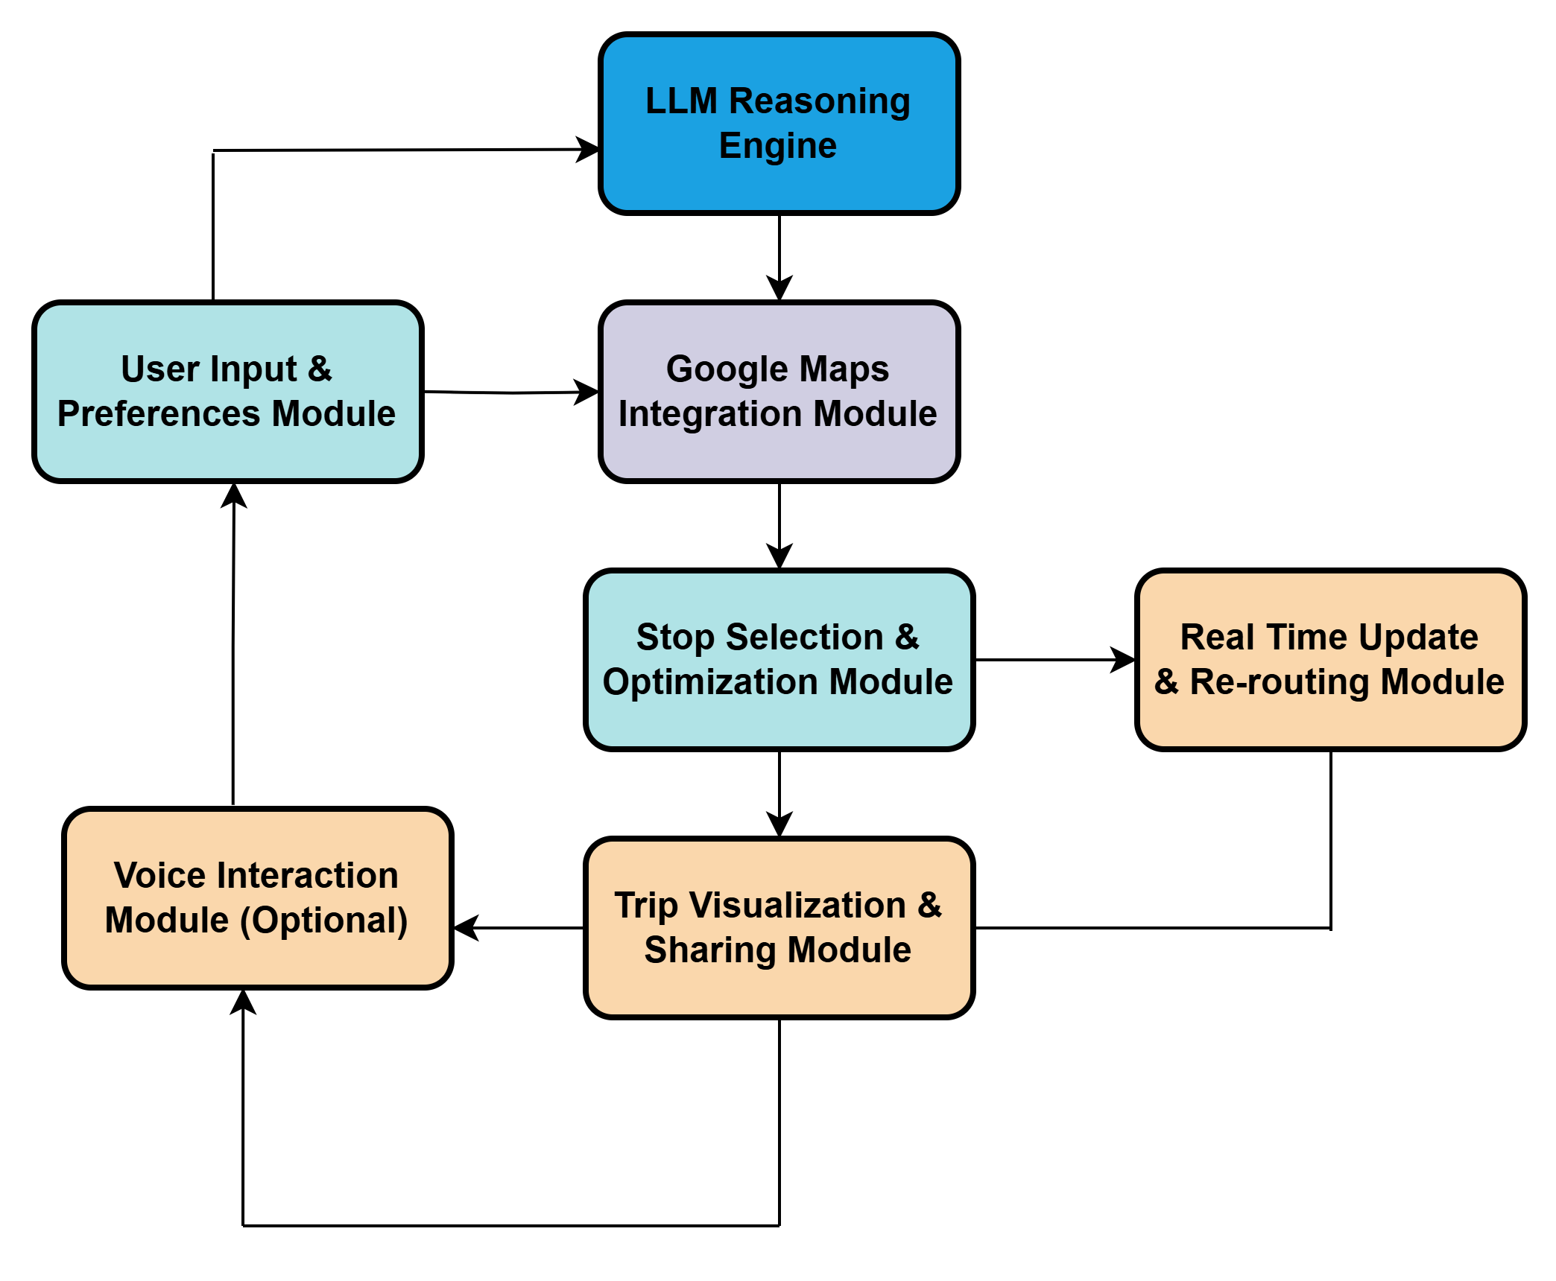
Multi-Agent AI Travel Planner with Real-Time Guidance
Modules to Cover

Slide 12
Multi-Agent AI Travel Planner with Real-Time Guidance
Initial Data Source and Identification
1. Google Maps APIs:
Directions API.
Geocoding API.
Maps JavaScript API.
Maps Embed API.
Maps Static API.
Gemini AI (LLM):
Natural Language Inputs.
User preferences (e.g., interests, vehicle type, time constraints).
Contextual Reasoning.

Slide 13
Multi-Agent AI Travel Planner with Real-Time Guidance
Identification Process
User Input Parsing
Destination.
Travel mode.
Interests (e.g., food, nature, history).
Constraints (e.g., time, budget).
Data Fetching via Google Maps APIs
Geocodes locations.
Retrieves nearby POIs by category.
Calculates optimal routes and travel times.
Generates map visuals (static or interactive).

Slide 14
Multi-Agent AI Travel Planner with Real-Time Guidance
Identification Process
Dynamic Selection & Structuring
Filters and prioritizes stops based on relevance and user context.
Structures the itinerary with logical sequencing.
Adapts in real-time without relying on stored historical data
Key Characteristics:
No static dataset.
Lightweight & scalable.
Context-aware personalization.
Real-time responsiveness.

Slide 15
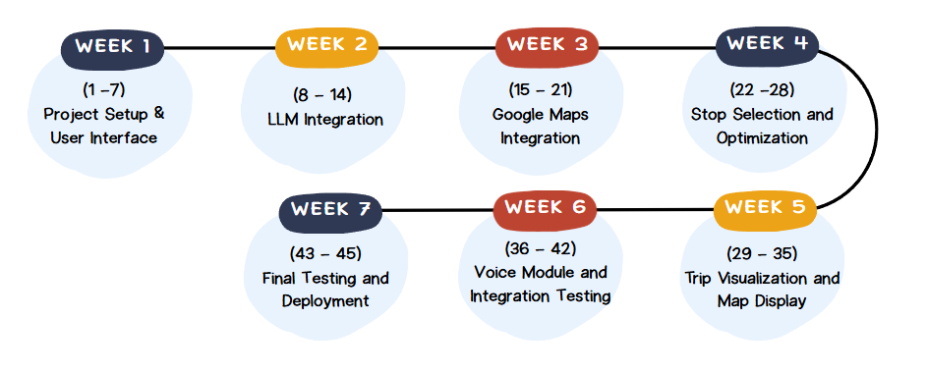
Multi-Agent AI Travel Planner with Real-Time Guidance
Project Plan and Timeline

